Slide 1
Statcast (Baseball) Analysis
Sean Norris, Alex To, and Shivani Sharma
w200 Project 2

Slide 2



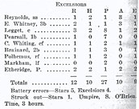
Anaytics are not new to baseball...
Since the beginning, analysts have been trying to use data to better understand the game
1859
First Box Score
1977
SABR
1985
Bill James Abstract
2006
Baseball Prospectus

Slide 3
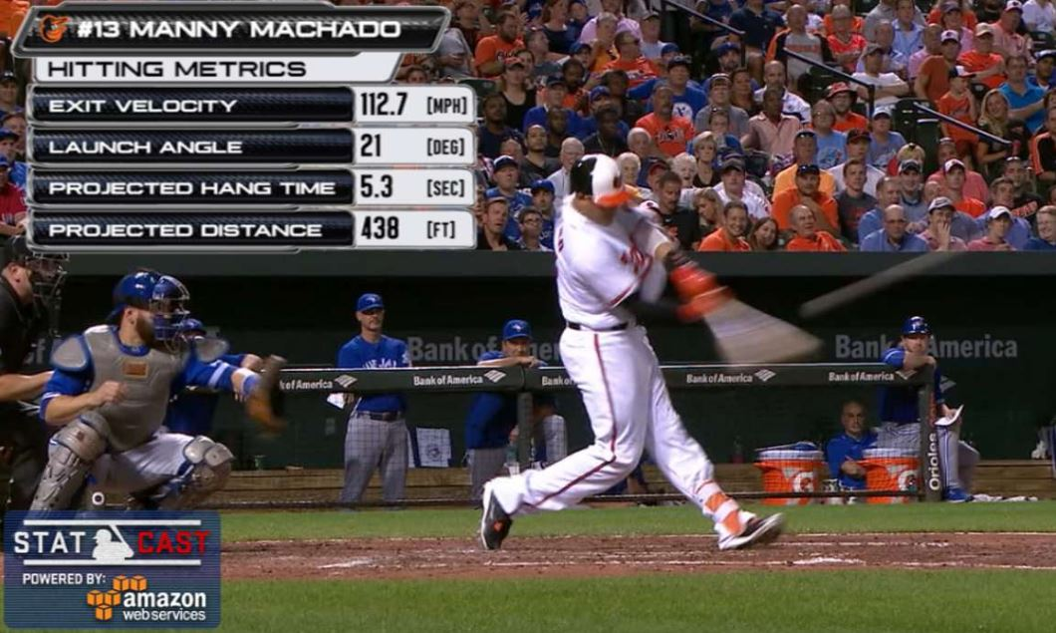

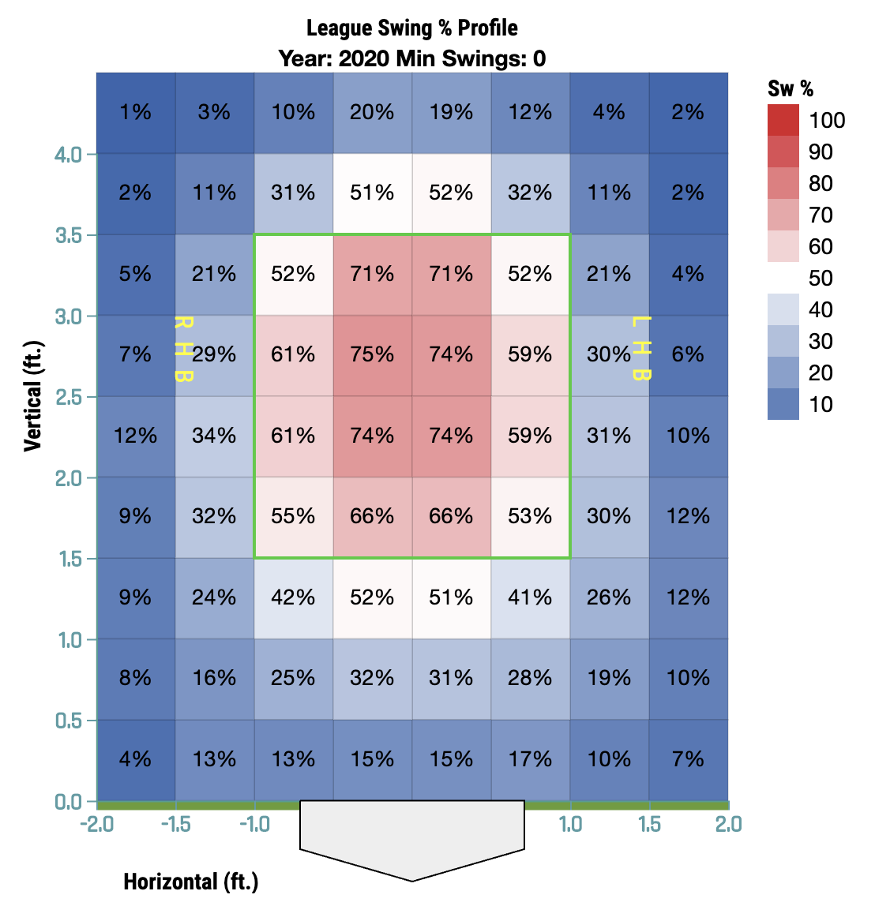
...and now our tools are better than ever
In 2015, MLB began tracking the flight of the ball with unprecedented accuracy, ushering in a new era

Slide 4
This prompted us to re-examine existing theory
Can we use Statcast data to better understand how player efforts contribute to macro trends?
Research Questions:
 | Prevailing Theory | Our Research Question
1 | Pitchers must establish the fastball | What’s the most effective pitch in baseball?
2 | Elevation has a linear affect on how far a ball travels | Do we see this effect on batted and pitched balls?
3 | “Clutch” hitters don’t exist | Do certain players hit better in crunch time?

Slide 5
Curveballs should move more than Fastballs
Q1
Combining certain fields and performing sanity checks helped us set up our analysis

Slide 6
Fastballs are the worst pitches in baseball
Q1
The pitches you see on the left are thrown faster than the pitches on the right

Slide 7
As hitters improve, pitchers try to adjust
Q1
As barrel percentages increase YoY, pitchers are trying to keep up by throwing more off-speed pitches

Slide 8
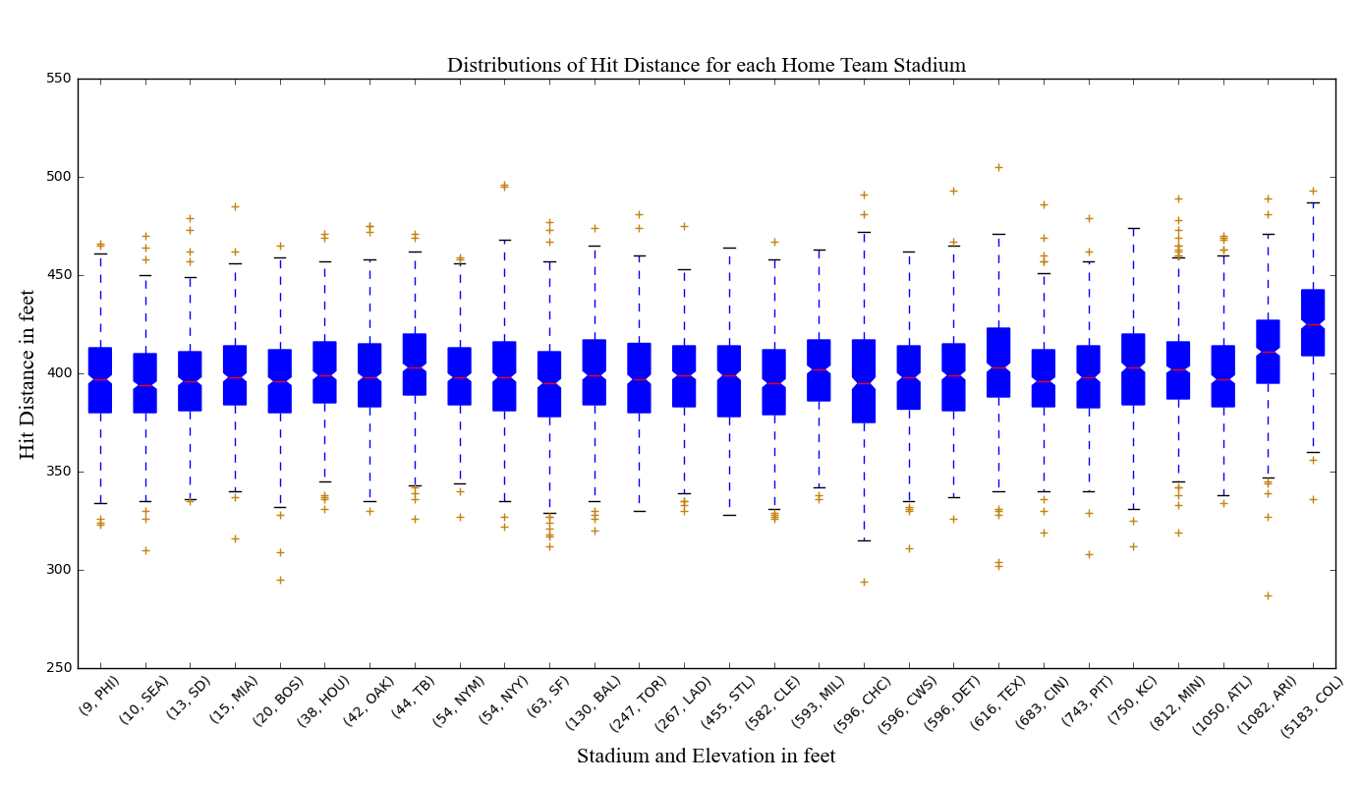
Balls should travel further the higher you are
Q2
Median hit distance increase with elevation for each home team stadium

Slide 9
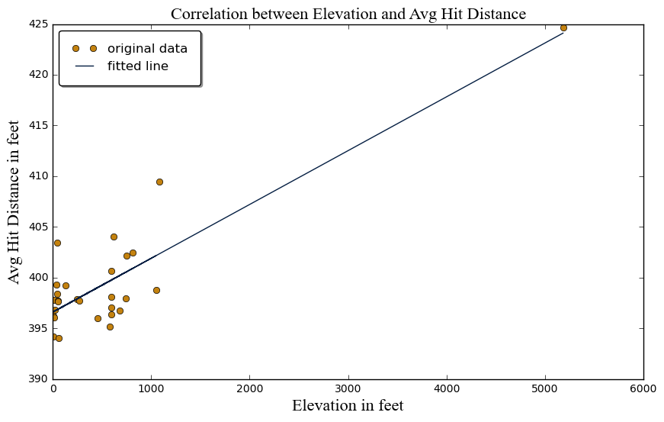
Elevation and hit distances are linearly related
Q2
The R-squared value tells us that 75.8% of average hit distance variation is explained by a linear model
Slope: 0.005310
Intercept: 396.583646
R-squared: 0.758013

Slide 10
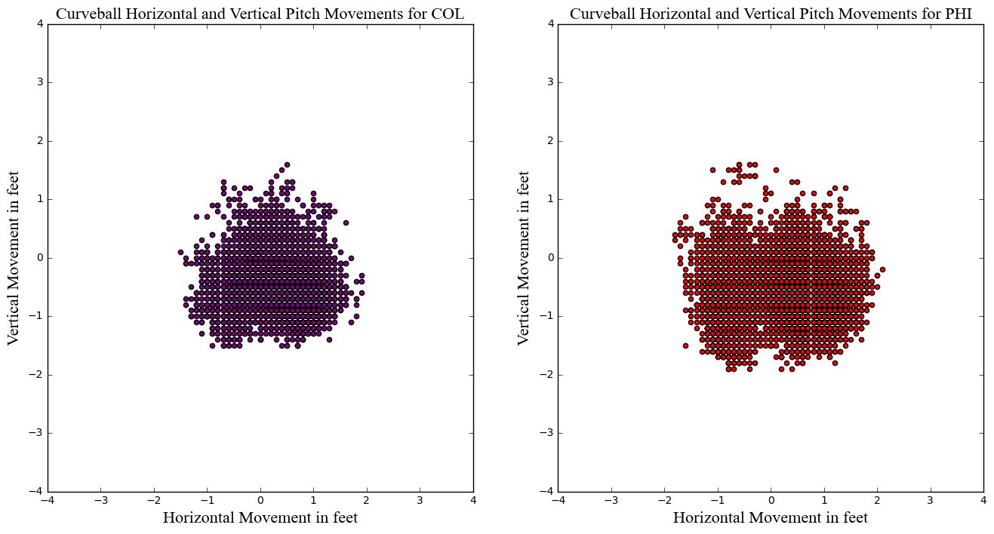
Pitches move less at higher elevations (1/2)
Q2
Let’s look at the effect that elevation has on Curveballs for COL and PHI….
pfx_x: the horizontal movement, in feet, of the pitch between the release point and home plate
pfx_z: the vertical movement, in feet, of the pitch between the release point and home plate
Curveballs move less in COL, we believe this would make them less effective

Slide 11
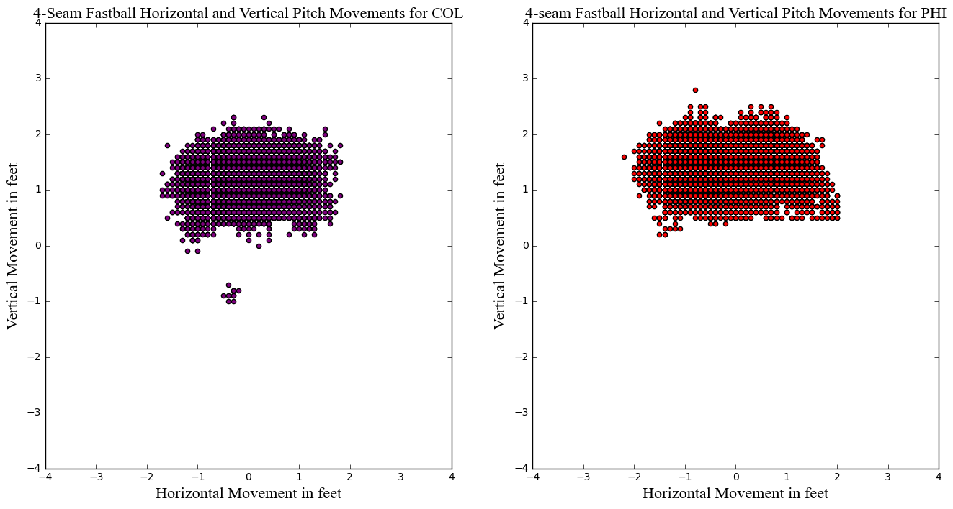
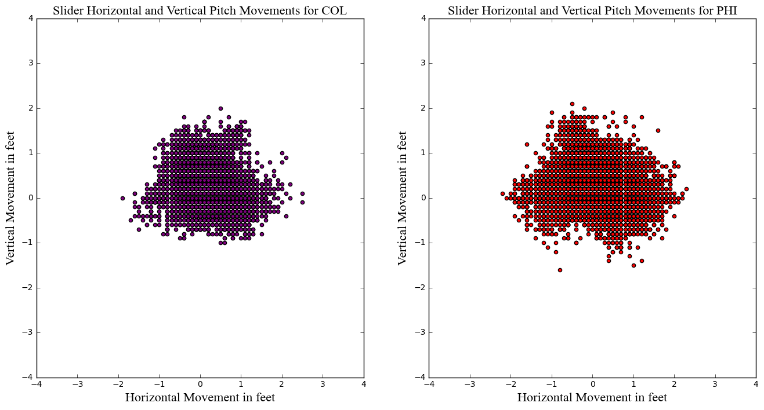
Pitches move less at higher elevations (2/2)
Q2
..and now lets study sliders and 4-Seam Fastballs
Vertical movement for fastballs is similar in both locations
Sliders seem to move slightly less in COL than they do in PHI

Slide 12
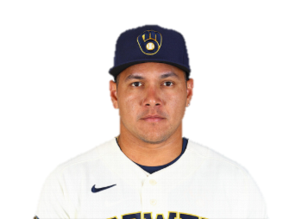

Who should you pick for a clutch at-bat?
Q3
With the game and, potentially season, on the line, who would you trust with the bat in hands?
Avisaíl García
Owner of a 103 OPS+
AKA the most average of the average
Corey Seager
2020 World Series MVP
Kind of a big deal in baseball

Slide 13
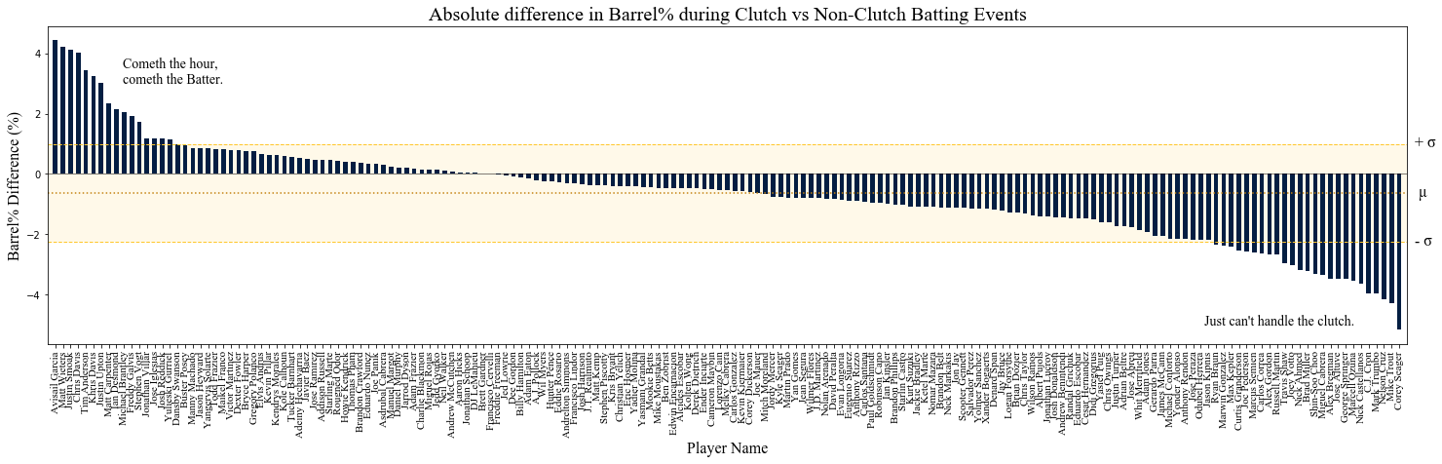
According the numbers: Avisaíl over all…
Q3
On average, players will “barrel” ~1 fewer ball per 100 in clutch situations
#4 Chris Davis (Lowest ever batting average for any qualified player in ‘18)
Second to Last: Mike Trout
(8x All star, 3x AL MVP)
#1: Avisaíl García (Rank 341 by barrel % in 2020)
Dead Last: Cory Seager (2020 World Series MVP)
13

Slide 14
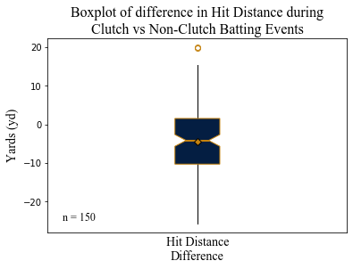
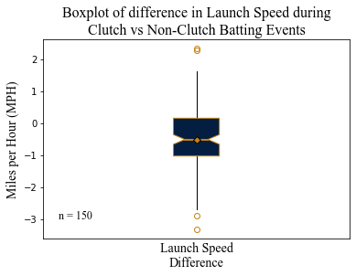
Most batters hit shorter and slower in the clutch
Q3
Batters hit, on average, 4.6 yards shorter, and 0.5 mph slower in the clutch
 | ∆Hit distance [yd] | ∆Launch Speed [MPH]
Avisaíl García | +1.44 | +1.19
Corey Seager | -11.24 | -1.14
14
14

Slide 15
So seriously, who should you pick?
Q3
Even though some hitters improve in the clutch, they may not improve enough to displace an all-star
For the average player, inter-season variance is greater than the clutch effect:
Median interseason Barrel% st.dev (all players): 2.66%
Median barrel% difference clutch vs non-clutch: -0.63%
2. However, for the players most affected by the clutch, the clutch effect is of the same magnitude as their interseason variance….
Name / Statistic | Barrel%
 | Interseason st.dev. | Clutch Difference | 2020 Barrel%
Garcia | 3.29 | +4.40% | 3.8%
Seager | 3.22 | -5.15% | 16.1%
3. But in this case, it’s still not enough to displace an all-star.

Slide 16
Thank You!

